Slide 1
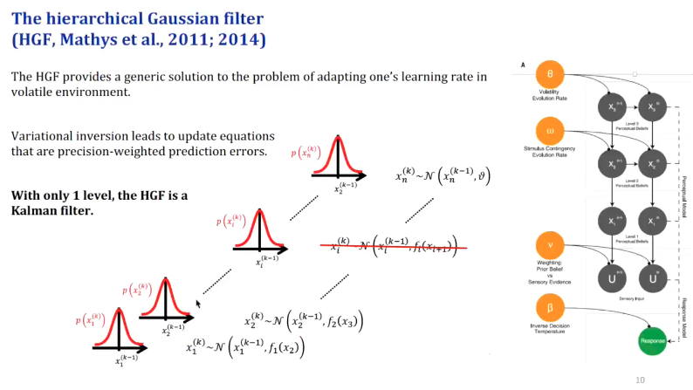
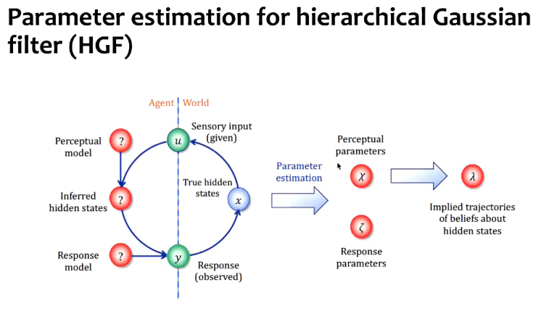
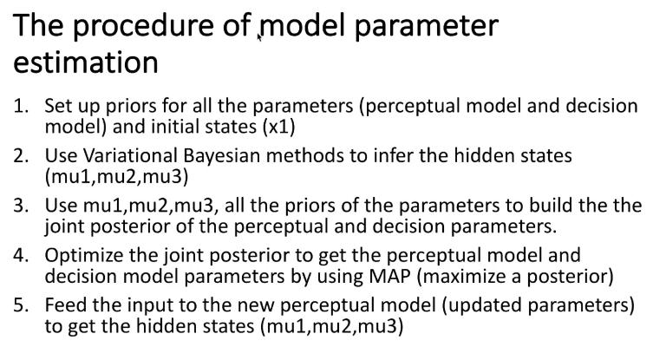

Slide 2
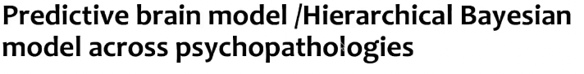
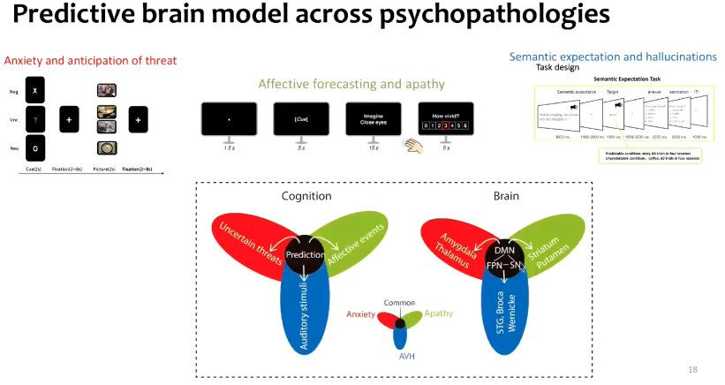
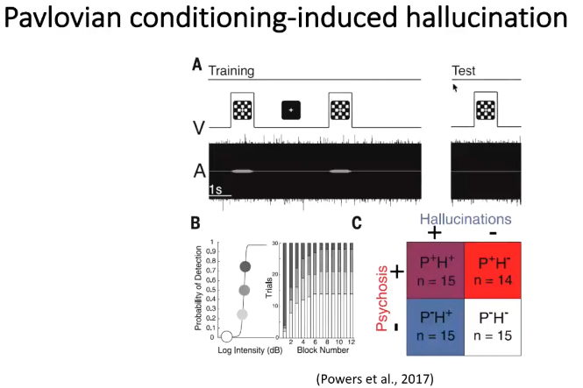
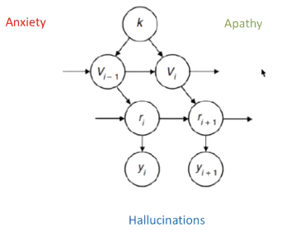
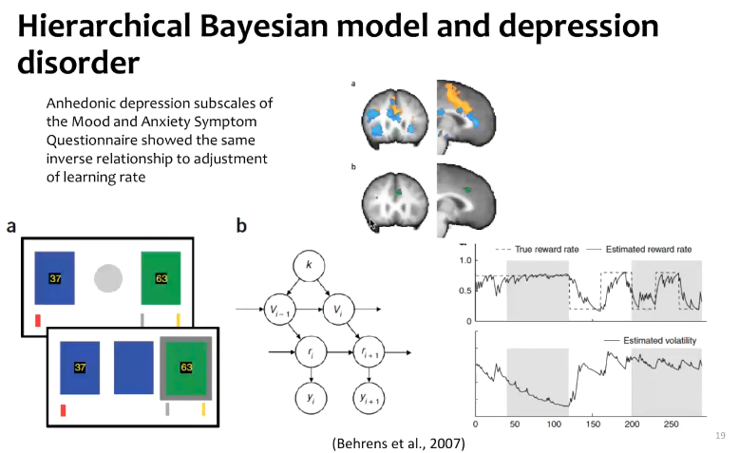
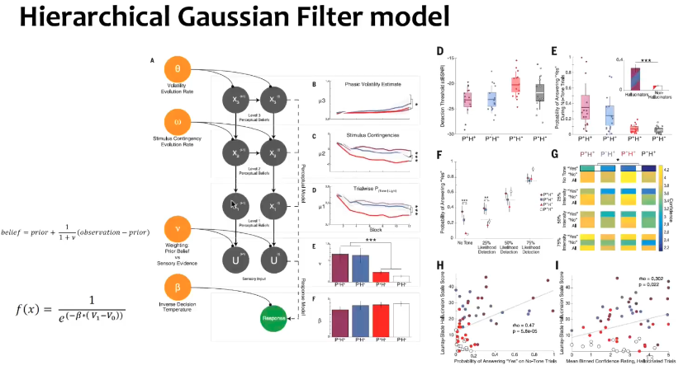

Slide 5
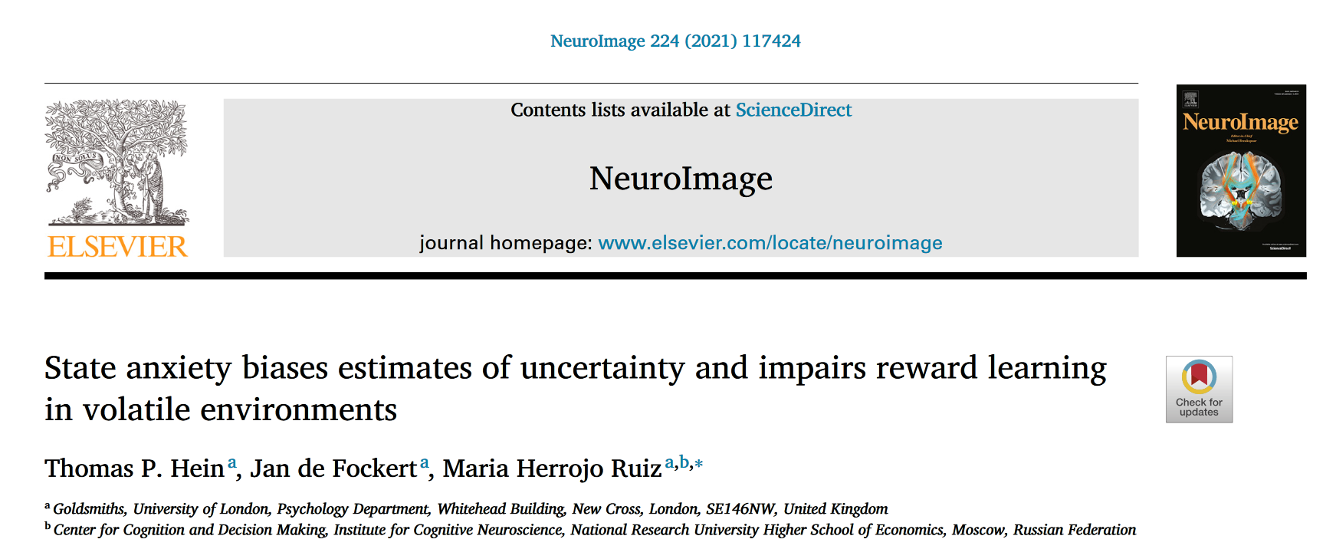
Reporter: YE HONGAI
2022/4/15
Notes:
https://www.bilibili.com/video/BV1sp4y1t72K/?spm_id_from=333.337.search-card.all.click&vd_source=c1b0eb876d2b6a978e5132f08d5f7422

Slide 6


Introduction
three types of uncertainty during decision-making and learning
expected (irreducible) uncertainty
estimation (informational) uncertainty
unexpected (environmental) uncertainty
Red : Green
7 : 3
Third information
Second information
Red : Green
7 : 3
Red : Green
2 : 8
Notes:
Expected uncertainty emerges from the probabilistic relationships between responses and their outcomes, which is an inherent (irreducible) property of most real-world interactions. Estimation uncertainty arises from the imperfect; information about those response-outcome relationships and decreases with learning. Lastly, changes in the environment (volatility) induce unexpected environmental uncertainty.

Slide 7
Hierarchical Gaussian Filter (HGF)

Slide 8
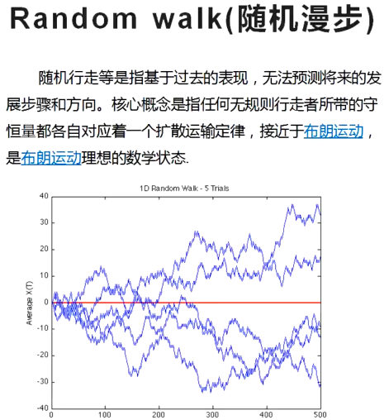
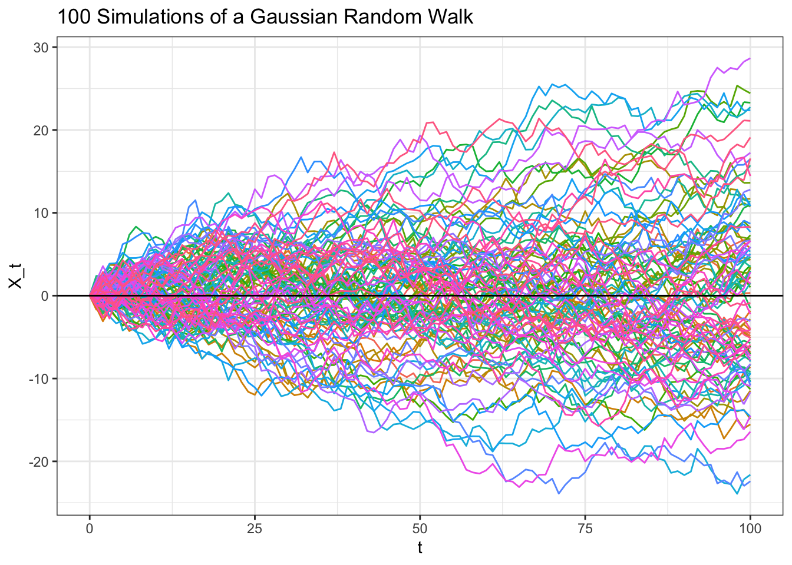
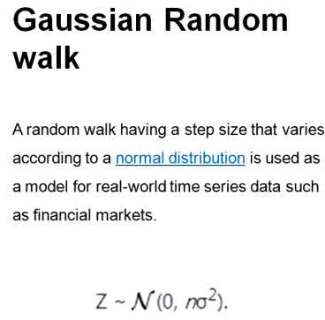
Gaussian random walks
A random walk having a step size that varies according to a normal distribution is used as a model for real-world time series data such as financial markets
高斯随机漫步的步长符合正态分布

Slide 9
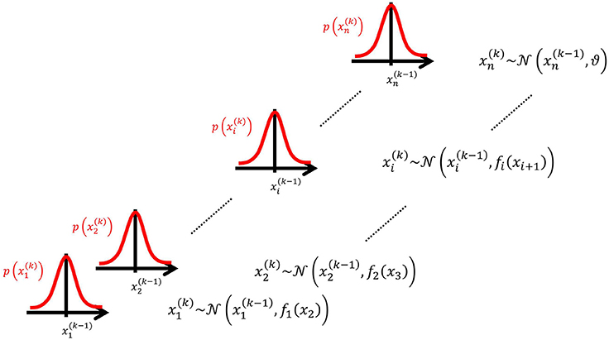
Hierarchical Gaussian Filter (HGF)
The model represents a hierarchy of coupled Gaussian random walks.
The levels of the hierarchy relate to each other by determining the step size (volatility or variance) of a random walk.
The topmost step size is a constant parameter ϑ.
http://www.translationalneuromodeling.org/tapas
Mathys, C. D., Lomakina, E. I., Daunizeau, J., Iglesias, S., Brodersen, K. H., Friston, K. J., & Stephan, K. E. (2014). Uncertainty in perception and the Hierarchical Gaussian Filter. Frontiers in Human Neuroscience, 8. https://doi.org/10.3389/fnhum.2014.00825

Slide 10

Hierarchical Gaussian Filter (HGF)
HGF : a generative model representing an approximately Bayesian observer estimating hidden states in the environment, a model of perception where beliefs about states are updated hierarchically.
Red : Green
7 : 3
First belief
Second belief
Third belief
The ball is red
The ball is green
Red : Green
2 : 8
Notes:
就是好比在一个看不见里面的黑盒子中抽球，一开始，你不知道盒子里有哪些颜色的球，也不知道自己会抽到什么颜色的球。然后，你开始抽球，第一次抽到了一个红色的球，这时候最底层的信念就更新了。即球是红色的，这是事实的直接反馈，抽出了绿球就会更新为球是绿色的。这是第一次抽球，后续你不断地抽不断地抽发现抽到红色的次数非常多，大概10次有7次能抽到红球，这时候你的第二个信念就更新了，即从黑盒子里抽到红球的概率是0.7，绿球的概率是0.3. 但是抽球游戏还没结束，你越往后抽却发现抽到绿球的次数明显增多了起来，变成了10次有8次是绿球。这时候，你又知道

Slide 11
Introduction
To reduce uncertainty, the brain is thought to appraise the inherent statistical structure of the world using probability distributions, continuously updating and inverting a hierarchical model of the causes of the sensory inputs it receives.
In this context, each type of uncertainty is expressed by the width (variance, or its inverse, precision) of the probability distribution of the corresponding belief.
difficulties estimating precision has been suggested to explain various clinical expressions
Variance Uncertainty
Notes:
movement difficulties in Parkinson’s disease to features of schizophrenia and autism

Slide 12
Introduction
Anxious individuals experience intolerance of uncertainty (IU)
Individuals high in trait anxiety have difficulties adapting their learning rate to changes in probabilistic task environments.
Healthy individuals are known to adapt their learning rate to volatility, with changing environments promoting a higher learning rate as new information needs to be integrated to better predict the future

Slide 13

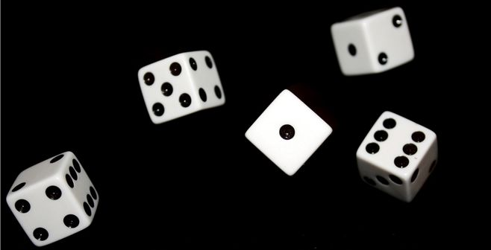
Purpose
Here we evaluated whether temporary anxious states in healthy individuals influence reward learning in a volatile environment through changes in informational and environmental uncertainty
Notes:
Evidence for a link between anxiety and inaccurate estimation of uncertainty would lend support to recent theoretical accounts suggesting that difficulties learning from incomplete information and misestimations of uncertainty are crucial to understanding affective disorders

Slide 14
Purpose
Here we evaluated whether temporary anxious states in healthy individuals influence reward learning in a volatile environment through changes in informational and environmental uncertainty
Notes:
Evidence for a link between anxiety and inaccurate estimation of uncertainty would lend support to recent theoretical accounts suggesting that difficulties learning from incomplete information and misestimations of uncertainty are crucial to understanding affective disorders

Slide 15
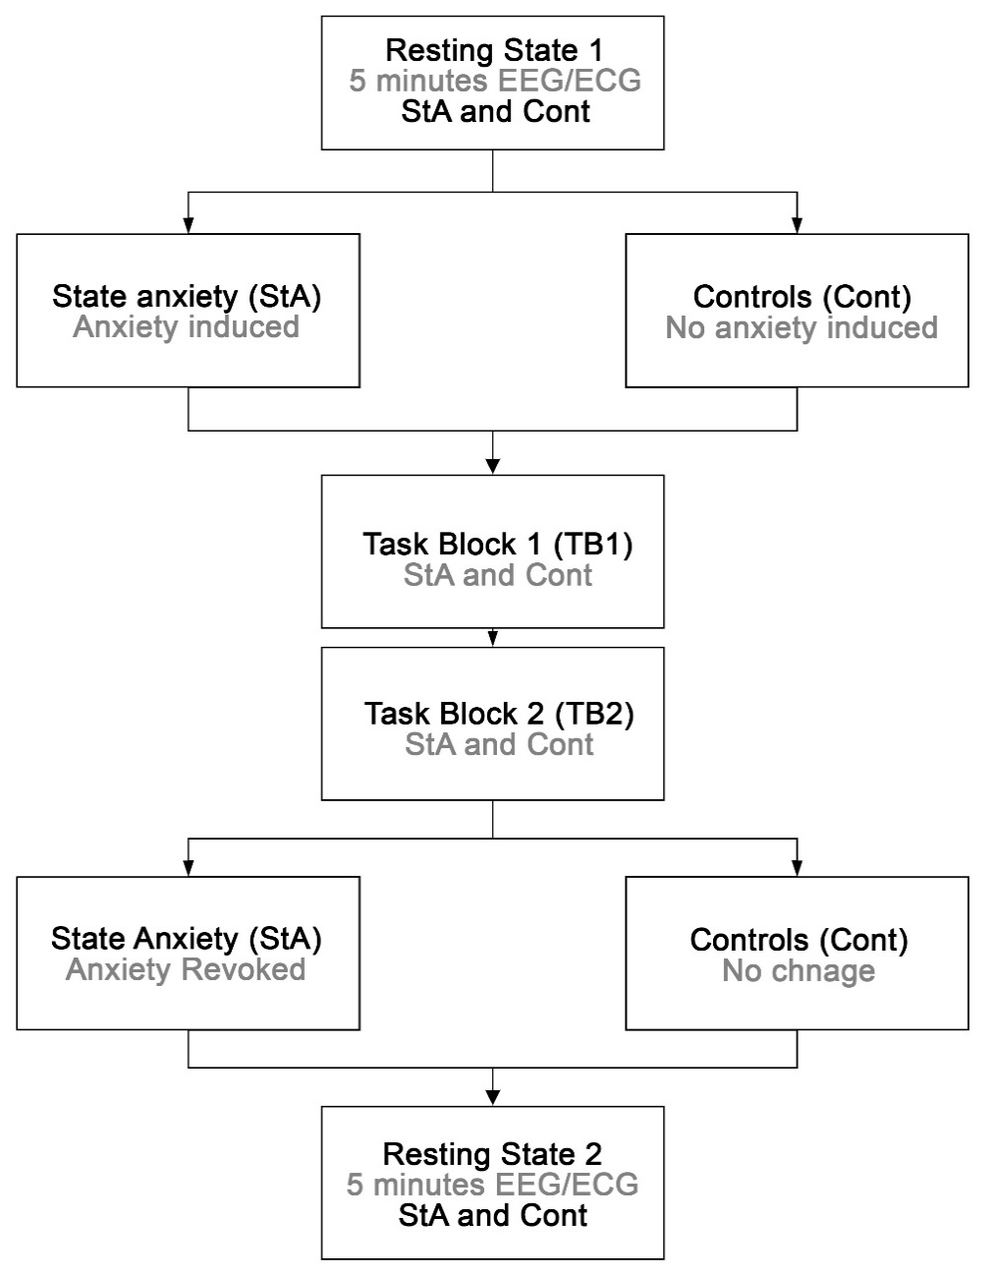
Methods
Participants:
Participants:
42 healthy individuals(age 18–35, 28 females, mean age 27)
2 groups: StA vs. Cont
Trait anxiety, sex, age controlled
State Anxiety Manipulation:
Present a piece of abstract art and would be allowed to prepare for 3 min for a 5 min public presentation of this artwork to a panel of academic experts (StA) / private description (Cont).
Notes:
heart-rate variability; after finishing the reward learning task
健康被试；
为了将被试的特质焦虑进行平衡，每个被试在参与正式实验之前填写Spielberger特质焦虑问卷，根据中位数将被试分为特质焦虑高和低两组；在诱发的状态焦虑组和控制组在年龄、性别和特质焦虑之间没有区别；
首先是5min的睁眼静息态：EEG/ECG；
焦虑诱发：公众演讲，
StA组的参与者被告知，他们在完成奖励学习任务后被随机选择去完成一项公开演讲任务。
他们被告知，他们将被要求展示一件抽象艺术作品，并被允许准备3分钟的时间，向学术专家小组进行5分钟的公开展示。而对照组则被告知，他们将得到一件抽象艺术作品，但同时他们要私下对自己进行心理描述。
焦虑消除：在完成基于奖励的学习模块后，StA参与者被告知评估小组突然不可用，并最终被指示与Cont组一致私下描述艺术品。
状态焦虑指标的评定：主观指标(问卷)和生理指标(HRV)，

Slide 16
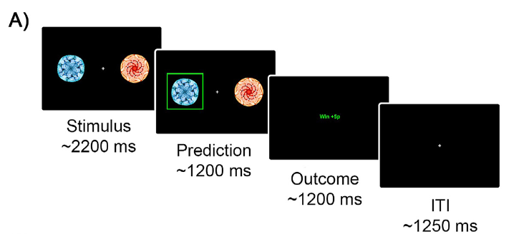
Methods
Design
participants were asked to predict which of the two visual icons was going to reward them with money(5 pence)
prediction time (2200 ms ± 200 ms)
display time (1200 ms ± 200 ms)
outcome time (1200 ms ± 200 ms) red or green
ITI 1250 ms ( ± 250 ms).
y_{i} = 1 (blue-rewarded)
y_{i} = 0 (blue-not rewarded)
u_{i} = 1 (blue-rewarded)
u_{i} = 0(blue-not rewarded)
Notes:
heart-rate variability; after finishing the reward learning task
左右边呈现不同的图标，被试需要在1.2s之内进行预测，预测哪边图标最有概率获得奖赏，第三屏是feedback；

Slide 17
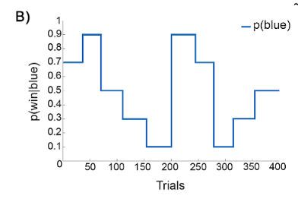
Methods
TB1
TB2
Design
Block1 : resting state (R1:baseline)
Block2 : reward learning task (TB1)
Block3 : reward learning task (TB2)
Block4 : resting state 2 (R2).
Contingencies(p(win | blue):
strongly biased (90/10)
moderately biased (70/30)
unbiased (50/50)
reverse (10/90; 30/70)
TB1 TB2: 200 trials each
Both resting state blocks were 5 min-long recordings of EEG and electrocardiography (ECG) with eyes open.
Randomly generated for each participant
Notes:
heart-rate variability; after finishing the reward learning task; so that over the two blocks there were 10 contingency blocks in total；

Slide 18
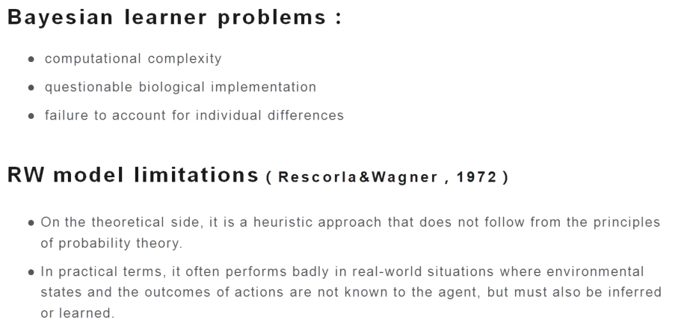
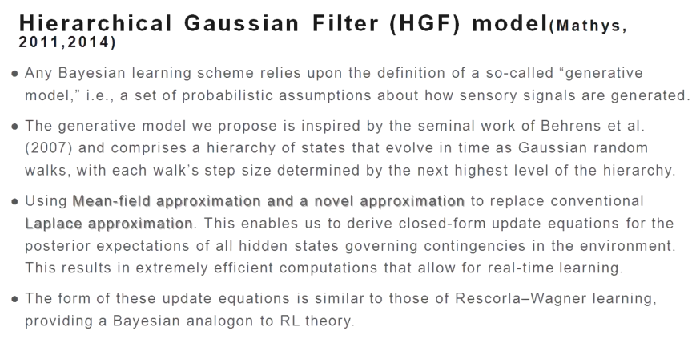
Hierarchical Gaussian Filter (HGF)
HGF: estimate each participant’s individual learning characteristics and belief trajectories during our binary reward learning task.
Changes to the contingencies were abrupt
HGF change slowly and diffusively over time.
Expect sudden changes :change-point models, etc.
Both approaches can successfully deal with both kinds of environments
Notes:
In our task, changes to the contingencies governing the outcomes were abrupt (see Fig. 1B), which is in contrast to the generative model of the environment suggested by the HGF, where states evolve as Gaussian random walks and thus change slowly and diffusively over time.
为什么在这项研究中使用HGFmodel呢？
贝叶斯模型计算复杂、无法解释个体差异、理论解释不明确；
RW模型不是概率模型；
分层高斯滤波(HGF)模型(Mathys, 2011,2014)
任何贝叶斯学习方案都依赖于所谓的“生成模型”的定义，即一组关于如何产生感官信号的概率假设。
我们提出的生成模型受到Behrens等人开创性工作的启发(2007)，并包括一个随时间演变的状态层次结构，作为高斯随机行走，每个行走的步长由层次结构的下一个最高级别决定。
用平均场近似和一种新的近似来代替传统的拉普拉斯近似。这使我们能够为控制环境中偶然性的所有隐藏状态的后验期望推导出封闭形式的更新方程。这导致了非常高效的计算，允许实时学习。
这些更新方程的形式类似于Rescorla-Wagner学习的形式，为强化学习理论提供了贝叶斯类比。

Slide 19
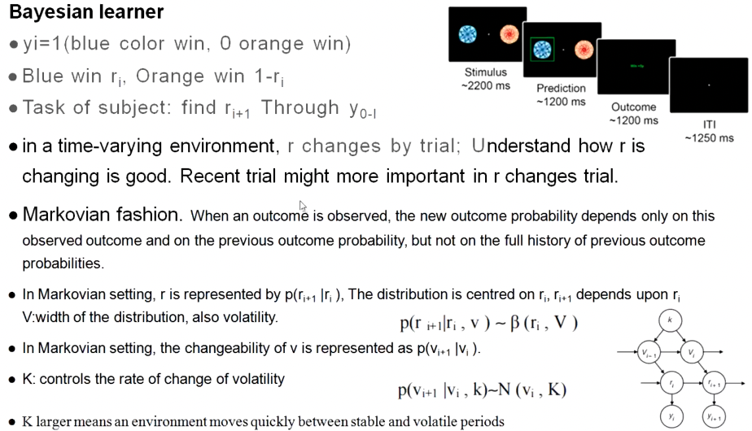
Notes:
贝叶斯学习yi=1(蓝色获胜，橙色获胜)蓝色赢r，橙色赢1-r刺激~2200 ms
被试任务:通过yo-i找到ri+预测~1200毫秒输出~1200毫秒在时变环境中，r随试验而变化;了解r是如何变化的很好。最近的试验可能更重要的是r变化试验。
马尔可夫链的时尚。当观察到一个结果时，新的结果概率只取决于这个观察到的结果和以前的结果概率，而不取决于以前结果概率的全部历史。
在马尔可夫环境中，r由p(r_{i+1} ｜r_{i})表示，分布以ri为中心，ri+取决于r,
V:分布的宽度，也是波动性。
p(ri+ri, v) ~β(r, v)
在马尔可夫环境中，v的可变性表示为p(Vi Vi)。
K:控制波动率的变化率Pp(Vi+ Vi, k)-N (Vi, k)

Slide 20
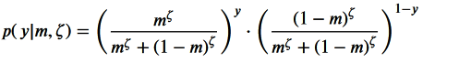
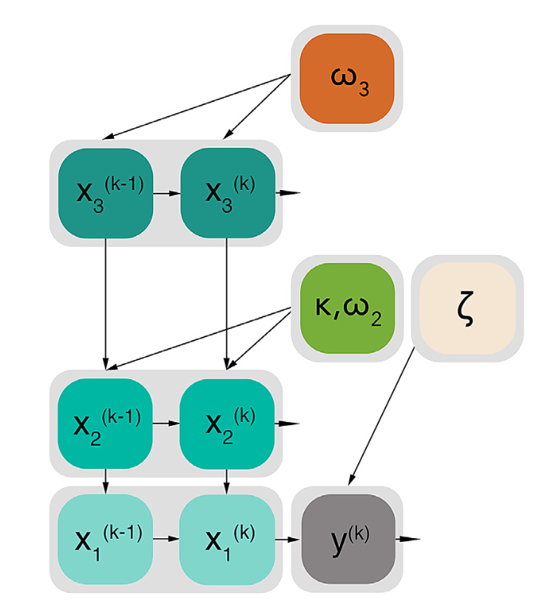
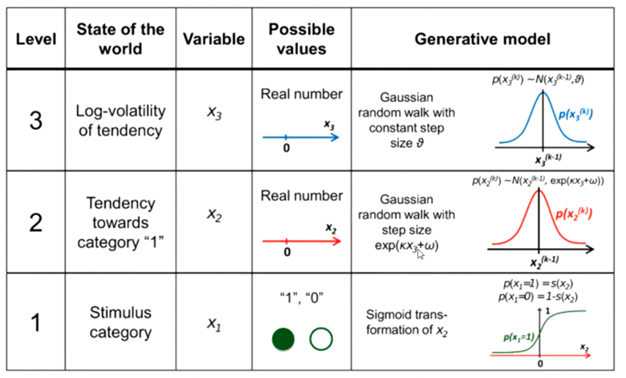

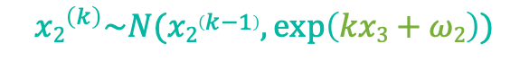
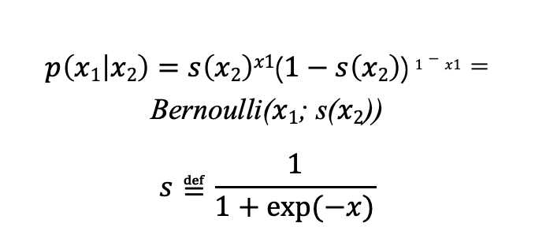
Hierarchical Gaussian Filter (HGF)
m(k): predictive probability
y^{(k)} : the decisions subjects made; (1: blue-reward; 0: blue-no reward
𝜁 were free parameters: decision noise,个人倾向：变化或者不变
The higher ζ ,the more likely the agent is to choose the option that is more likely according to its current belief.
$${x3}^{\left(k\right)}\sim N({x3}^{\left(k−1\right)}, exp\left(ω3\right)⁡)$$
$${x2}^{\left(k\right)}\sim N({x2}^{\left(k−1\right)}, exp\left(kx3+ω2\right)⁡)$$
$p\left(x1 | x2\right)=s\left(x2\right)x1$($1−s\left(x2\right)$) $1−x1$ = Bernoulli($x1$; s($x2$))
$$s≝\frac{1}{1+exp⁡(−x)}$$
Like 0-1/伯努利 distribution: $p\left(u | x1\right)=\left(u\right)x1\left(1−u\right)1−x1$
激活函数：sigmoid function：unit-square sigmoid observation model for binary responses
Notes:
This perceptual model can then be coupled to a response model that associates belief estimates to decisions.
在模型的最低层，隐藏状态$x1$对应于二进制实验刺激的分类变量:在trial k，蓝色符号是否被奖励(${x1}^{\left(k\right)}$= 1;蓝色有奖励，橙色无奖励)或(${x1}^{\left(k\right)}$= 0;蓝色无奖励，橙色有奖励)。
状态$x2$描述了刺激结果偶然性趋势的真实值（出现奖赏的概率）。这被定义为在看到输入之前和之后$u2$的sigmoid变换，相对于观察到的输入和它的预测之间的差。
状态$x3$表示任务环境中的阶段性对数波动;也就是第二层的变化率。
作为response模型，我们使用二元反应的单位平方sigmoid观察模型(Iglesias et al.， 2013;Mathys et al.， 2014)。
这将试次k刺激的预期奖赏m(k)(例如，蓝色) -这是当前信念的函数-转换为概率p(y(k)= 1)和p(y(k)= 0)，参与者将选择该刺激(蓝色，1)或替代方案(橙色，0):反应模型的参数7的值越高，参与者更有可能选择与他们当前对奖励刺激的信念相对应的反应。

Slide 21
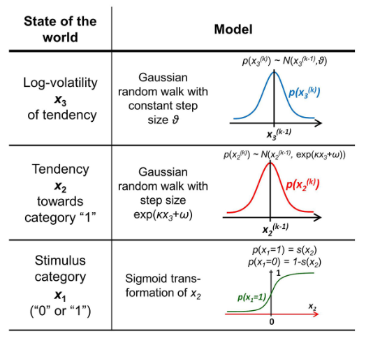
Hierarchical Gaussian Filter (HGF)
3-level HGF :
x₁: binary categorical variable of the experimental stimuli
Trial k
Blue Rewarded x₁^{(k)} = 1
Blue not rewarded x₁^{(k)} =0
Notes:
This perceptual model can then be coupled to a response model that associates belief estimates to decisions.

Slide 22
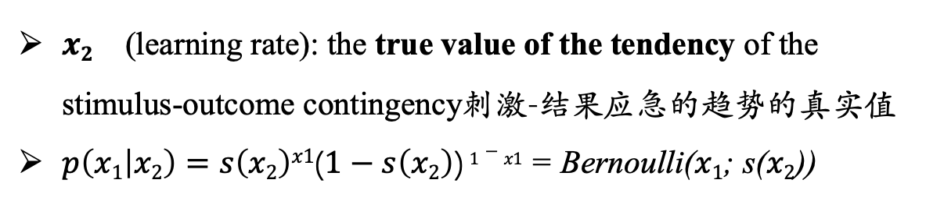
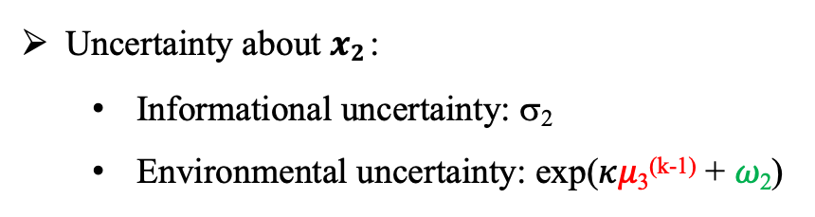
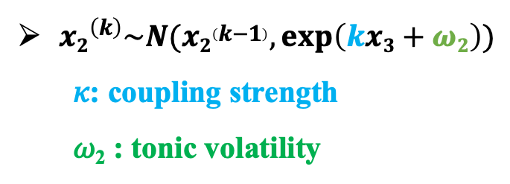
Hierarchical Gaussian Filter (HGF)
3-level HGF :
${x2}^{}$ (learning rate): the true value of the tendency of the stimulus-outcome contingency刺激-结果应急的趋势的真实值
$p\left(x1 | x2\right)=s\left(x2\right)x1$($1−s\left(x2\right)$) $1−x1$ = Bernoulli($x1$; s($x2$))
${x2}^{\left(k\right)}\sim N({x2}^{\left(k−1\right)}, exp\left(kx3+ω2\right)⁡)$
𝜅: coupling strength
𝜔₂ : tonic volatility
0.5-0. 3-0.25-0.21-0.20
Uncertainty about $x2$:
Informational uncertainty: σ₂
Environmental uncertainty: exp(𝜅𝜇₃^{(k-1)} + 𝜔₂)
0.5±0.4
phasic volatility
tonic volatility
可以 测量最底层期望值的变化，并将其解释为隐含的学习率（𝛼）。
这被定义为相对于观察到的输入𝜇和其预测s(𝜇₂)之间的差异，看到输入前和看到输入后的sigmoid变换的差异。
We can then measure the change in expectation at the lowest level and interpret it as an implied learning rate (𝛼).This is defined as the sigmoid transformed difference between 𝜇2 before seeing the input and after seeing it, relative to the difference between the observed inputs u and its prediction s(𝜇2)
High volatility estimates (𝜇₃) increase the speed with which beliefs at level 2 change.
Larger values of the tonic (time-invariant) part of the variance (𝜔₂) generally increase the step size of x₂.
Notes:
This perceptual model can then be coupled to a response model that associates belief estimates to decisions.
高的波动率估计值（𝜇3）增加了第 2 层信念变化的速度。
方差的调和（时间不变）部分（𝜔2）的值越大，通常会增加x2的步长。
这个感知模型可以和一个反应模型结合起来，将信念估计与决策联系起来。无论当前的（估计的）波动率水平如何，在第2级上的信念更新更快?????。

Slide 23
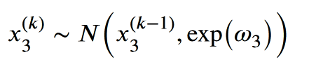
Hierarchical Gaussian Filter (HGF)
3-level HGF :
x₃: represents the phasic log-volatility within the task environment; that is, the rate of change on the second level.
(Bayesian surprise)
ω₃: constant parameter
σ₃: variance on level 3
belief uncertainty about volatility
representing imperfect knowledge about how the reward outcome contingencies are changing across time
0-0.1-0.9-0.3
0-0.1-0.3-0.1
Notes:
This perceptual model can then be coupled to a response model that associates belief estimates to decisions.

Slide 24
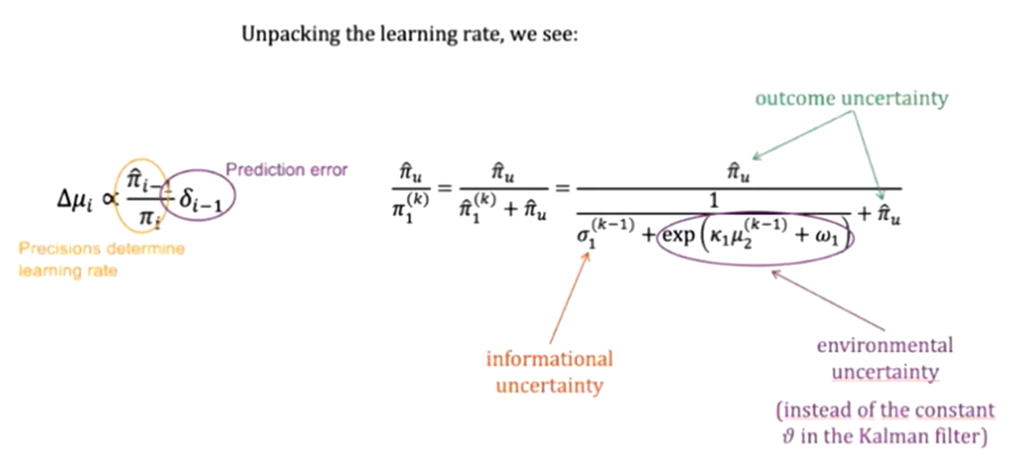
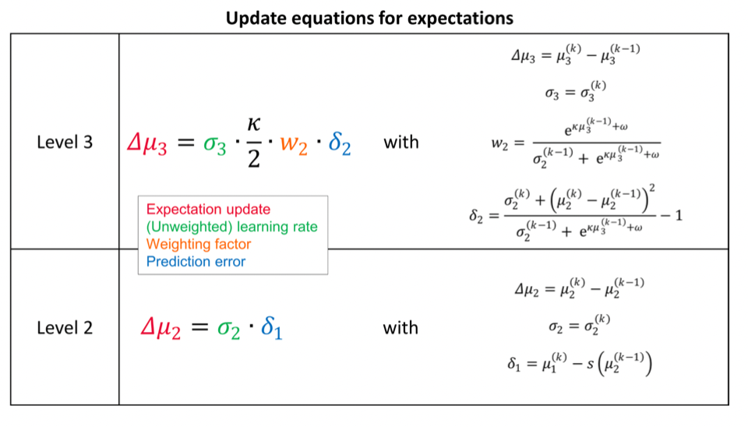
Notes:
π表示方差的倒数，也就是说表示的是精读；

Slide 25
Observing the observer” framework
First, the agent’s perception of (inference about) its environment, i.e., the posterior estimates provided by the agent’s model of how its sensory input is generated.
Second, the agent’s observed actions (i.e., decisions or responses) which are (probabilistic) consequences of the agent’s beliefs about its environment.
We call the first model perceptual, while the second is the decision or response model.

Slide 26
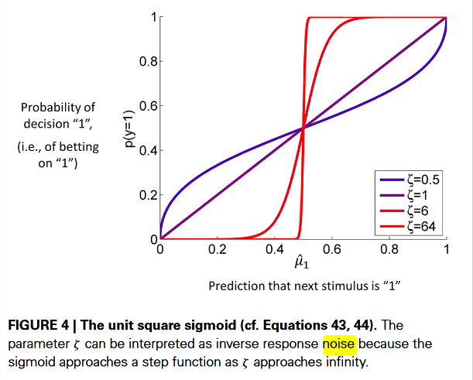
Hierarchical Gaussian Filter (HGF)
𝜁 were free parameters: noise
m(k): predictive probability
y^{(k)} : the decisions subjects made;
1: blue-reward
0: blue-no reward
The higher ζ ,the more likely the agent is to choose the option that is more likely according to its current belief.
unit-square sigmoid observation model for binary responses
Notes:
This perceptual model can then be coupled to a response model that associates belief estimates to decisions.

Slide 27
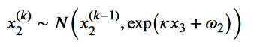
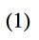
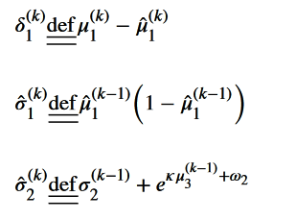
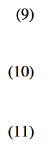
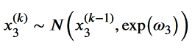
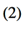
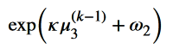
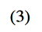
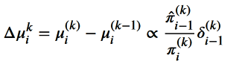
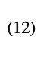
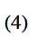
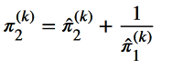
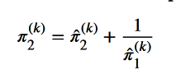
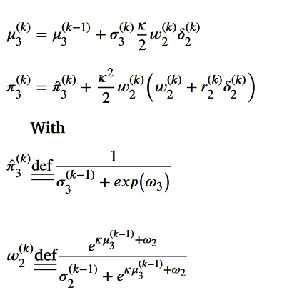
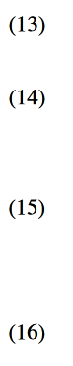
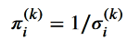








Slide 28


Slide 29



Hierarchical Gaussian Filter (HGF)
low (̂πu = 1000, top panel) and high (̂πu = 10, bottom panel) sensory uncertainty.
μ(0) 2 = μ(0) 3 = 0, σ (0) 2 = σ (0) 3 = 1, κ = 1, ω =−3, and θ = 0.7, ζ = 8.

Slide 30
Hierarchical Gaussian Filter (HGF)
In the case of low input precision, the volatility estimate keeps declining because most of the variation in input is attributed to noise instead of fluctuations in the underlying tendency toward one outcome category x1 or the other.
less consistent in favoring one option over the other at any given time. This accords well with recent accounts of psychopathological symptoms as a failure of sensory attenuation

Slide 31
Statistics
Dependent variables:
(a) model-free behavioural measures (error rate, reaction time: RT);
non-parametric factorial synchronised permutations tests with 5000 permutations
Group (StA, Cont) and Block (1,2)
Notes:
we found a significant main effect of factor Block on the HRV index, indicating that the anxiety manipulation led to different physiological changes as a function of the block number.

Slide 32

Model-free Analysis
Percentage of errors: whether anxiety impairs reward-learning task performance
non-parametric factorial test :
Group (p = 0.01)
Block only a trend (p = 0.056).
interaction effect (p = 0.66).
between-group comparison
pair-wise permutation tests
StA group (mean 38.0, SEM 0.97)
Cont group (mean 35.6, SEM 0.66, p = 0.001, Δ=0.70, CI = [0.58, 0.82]
Notes:
signals in our task converge with the windows of the fERN and P300 effects reported in previous studies

Slide 33
Model-free Analysis
Block on RTs (p = 0.02); Group or interaction effect (p = 0.64, p = 0.26)
Post-hoc analyses on the Block :
StA :
TB1 (mean 658.3, SEM 32.53)
TB2 (mean 552.8, SEM 20.68 (PFDR = <0.05, Δ=0.73, CI = [0.65, 0.81]).
Cont
TB1 (mean 657.7, SEM 35.65)
TB2 (mean 591.4, SEM 31.78, PFDR = <0.05, Δ = 0.65, CI = [0.56, 0.72]).
StA + Cont mean RT of lose and win trials.
The lose minus win RT difference was highly significant, reflecting a slower response on trials where participants responded incorrectly (p = 0, Δ=1, CI = [1, 1]; mean RT for lose trials 639.8 ms [SEM 0.36 ms], and for win trials 600.8 ms, [SEM 0.33 ms],
Notes:
in line with previous work on anxiety (Bishop, 2009). As a separate analysis, and given the lack of between-group differences in RTs, we contrasted the total-population

Slide 34
Hierarchical Gaussian Filter (HGF)
Bayesian belief updating :
not tractable analytically and difficult to evaluate in real time.
computational burden
No individual difference
‘Bayesian brain hypothesis’, can’t be combined with EEG, etc
To fill this gap and provide a generic, robust and flexible framework for analysis of trial-wise data from the Bayesian brain perspective, we recently introduced the Hierarchical Gaussian Filter (HGF), a hierarchical Bayesian model
Based on a mean field approximation to the full Bayesian solution, we derived analytic update equations whose form resembles RL updates, with dynamic learning rates and precision-weighted prediction errors(pwPEs).
Notes:
it requires computing complicated integrals which are not tractable analytically and difficult to evaluate in real time.
restricted by the computational burden imposed by these models and the assumption that the learning process was identical across subjects; rest on variational Bayesian techniques which optimize a free-energy bound on the surprise about sensory inputs, given a model of the environment, and represent a special case of the general “Bayesian brain” hypothesis

Slide 35


Bayesian Model Selection
HGF_{fam}:
3-Levels [HGF3]
2-Levels [HGF2]
HGF𝜇₃ replace ζ with μ₃
Rl_{fam}：
Rescorla Wagner [RW]
PEs drive belief updating but with a set learning rate (Rescorla and Wagner, 1972)
Sutton K1 [SK1]
permits the learning rate to change with recent prediction errors
The family of Bayesian models (HGF3, HGF2, and HGF𝜇3) had much stronger evidence than the reinforcement-learning models (RW, SK1), with an exceedance probability of 0.99, and an expected frequency of 0.74
much stronger evidence for the HGF₃ model relative to the HGF2 and HGF𝜇3 model versions, with an exceedance probability of 0.98 and an expected frequency of 0.61
Notes:
signals in our task converge with the windows of the fERN and P300 effects reported in previous studies

Slide 36

Hierarchical Gaussian Filter (HGF)
μ₃⁽⁰⁾⁼¹ following de Berker et al., (2016)
The initial uncertainties of these beliefs (𝜎₂⁽⁰⁾ = 0.1 and 𝜎₃⁽⁰⁾ = 1) corresponded to the default settings of the toolbox, and we verified that these values had a negligible impact of the estimated belief trajectories.
Assess reliability
70 agents for nine different values of 𝜔2 (total 630 simulations), Cont participant #1
similar to 𝜔3 and 𝜁
high accuracy for estimating 𝜔2 and 𝜁
while 𝜔3 was poorly recovered.
Similar results in StA participant #1
𝜔₃ excluded for group analysis
Notes:
To assess the reliability of our estimates for the free model parameters in our implementation of the HGF (winning model, see model comparison details below), we simulated behavioural responses of 70 agents for nine different values of 𝜔2 (total 630 simulations), when observing the input of Cont participant #1. Similar simulations were run to estimate parameters 𝜔3 and 𝜁 .This analysis demonstrated high accuracy for estimating 𝜔2 and 𝜁 , while 𝜔3 was poorly recovered. Poor estimation of 𝜔3 has also been reported in a recent study using a different approach (Reed et al., 2020). A complementary analysis using simulated responses to observed inputs from StA participant #1 provided very similar results (Supplementary Figure 3).

Slide 37

Supplementary Figure 5. Model check. Simulated responses were generated using the estimated model parameters for each individual (ω₂, ω₃, ζ). We compared the probability of trial-to-trial response switch (Orange, Blue) between simulated and empirical data across participants computing the non-parametric Spearman rank correlation. There was a very high and significant rank correlation between both variables (N = 42): ρ = 0.8679, P = 4 x 10⁻¹⁴. Inspection of this association within each participant group revealed similar values (N = 21 in each case): ρ_{Cont} = 0.8263, P_{Cont} = 4 x 10⁻⁶; ρ_{StA} = 0.8355, P_{StA} = 2.5 x 10⁻⁶.

Slide 38
Statistics
non-parametric factorial synchronised permutations tests with 5000 permutations
Dependent variables:
(c) HGF perceptual model parameter 𝜔₂ (tonic volatility);
(d) Decision noise of the response model, 𝜁 ;
Relevant HGF quantities:
(i) informational uncertainty about the reward tendency x2 (𝜎2);
(ii) estimates of belief on volatility (mean, 𝜇₃, and variance, 𝜎₃);
(iii) environmental uncertainty—related to volatility in the environment: exp(𝜅𝜇₃ + 𝜔₂).
Group (StA, Cont) and Block (1,2)
Notes:
we found a significant main effect of factor Block on the HRV index, indicating that the anxiety manipulation led to different physiological changes as a function of the block number.

Slide 39

Model-based Analysis
𝜔₂
StA (mean -3.1, SEM 0.23)
Cont group (mean -2.0, SEM 0.15, p = 0.002, effect size: Δ=0.75, CI = [0.55, 0.90]).
decision noise parameter, 𝜁 ,
group (p = 0.62)
Cont (mean 1.98 [0.26]) and StA (2.20 [0.41]).

Slide 40

α
κx₃
σ₂
exp(κx₃+ω₂)
ω₂
σ₃

Slide 41
Statistics
non-parametric factorial synchronised permutations tests with 5000 permutations
Dependent variables:
(c) HGF perceptual model parameter 𝜔2 (tonic volatility);
(d) Decision noise of the response model, 𝜁 ;
Relevant HGF quantities:
(i) informational uncertainty about the reward tendency x₂ (𝜎₂);
(iii) environmental uncertainty—related to volatility in the environment: exp(𝜅𝜇₃ + 𝜔₂)
(ii) estimates of belief on volatility (mean, 𝜇₃, and variance, 𝜎₃);
Group (StA, Cont) and Block (1,2)
Notes:
we found a significant main effect of factor Block on the HRV index, indicating that the anxiety manipulation led to different physiological changes as a function of the block number.

Slide 42

Model-based Analysis
Informational uncertainty x₂
Group on 𝜎₂ (p = 0.008)
block and interaction effect (p = 0.58, p = 0.78)
anxiety significantly lowered the total average 𝜎₂ for StA in comparison to Cont, as expected from the lower 𝜔₂ values in StA (p = 0, Δ=0.75, CI = [0.55, 0.89]).
A lower belief uncertainty about the outcome tendency in StA individuals means that new information had a smaller impact on the update equations for beliefs about x₂ in this group

Slide 43

Model-based Analysis
exp(𝜅𝜇3 + 𝜔2).
Environmental uncertainty
induced by changes in the environment—depends on the tonic volatility estimate, 𝜔₂, and the trial-wise volatility estimate 𝜇₃^{(k-1)}
Group (p = 0.02)
Block or interaction effect (p = 0.58, p = 0.75).
Further pair-wise analyses demonstrated:
the StA group underestimated the environmental uncertainty (p = 0, Δ= 0.74, CI = [0.54, 0.89])
Notes:
, relative to control participants, when averaging across both experimental blocks. consistent with their reduction in 𝜔2.

Slide 44

Model-based Analysis
Uncertainty about volatility x₃
Block (p = 0.0006)
Group on this parameter (p = 0.0002)
interaction effect (p = 0.99)
Across blocks, the uncertainty about volatility generally decreased.
Comparisons demonstrated:
separately in the first and second task blocks anxiety significantly increased 𝜎₃ in the StA group when compared to the Cont group (PFDR < 0.05, effect size for TB1: Δ=0.73, CI = [0.53, 0.89]; TB2: Δ=0.74, CI = [0.53, 0.89]).
The larger anxiety induced uncertainty about volatility is consistent with the effect of decreasing 𝜔₂, as illustrated in our simulations

Slide 45
Key Findings
α
κx₃
σ₂
exp(κx₃+ω₂)
ω₂
σ₃
Our modelling results offer a mechanistic explanation for the increase in error rate that we observed in the anxiety group.

Slide 46

EEG and ECG Recording
Data collection
BioSemi ActiveTwo system (64 electrodes, extended international 10–20)
a sampling rate of 512 Hz.
ECG:
QRS-complex and its main peak, the R wave peak.
inter-beat interval: IBI: the difference intervals between consecutive R peaks
Coefficient of Variation (CV) : the latency of the R-peak
HRV : The CV of inter-beat intervals was used as a metric of heart rate variability for statistical testing and is termed HRV
block-wise state anxiety changes
Notes:
= standard deviation/mean

Slide 47
Results
Block (p = 0.009)
Group (p = 0.04)
lower HRV in anxiety
Notes:
signals in our task converge with the windows of the fERN and P300 effects reported in previous studies

Slide 48
EEG
Process
downsampled to 256 Hz, lowpass filtered at 30Hz and converted to SPM 12
64 channels and 168 time points using a voxel size of 4.2 mm × 5.4 mm × 4 ms
Signals:
Error Related Negativity(ERN): an event-related potential(ERP) triggered by overt errors around 100ms
Feedback ERN(fERN): follows negative feedback around 250ms (Bayesian surprise）
P300: sensitive to reward PEs, valence, and surprise (peaking between 250−500 ms with a parietal topography
Notes:
heart-rate variability; after finishing the reward learning task; so that over the two blocks there were 10 contingency blocks in tota

Slide 49
EEG analysis
Outcome (lose versus win) on the EEG signals (the fERN and P300 )
Window :100 ——1000 ms (includes the latency of those previously reported ERP components.
Permutation tests with a cluster-based threshold correction to control the family-wise error (FWE) at level 0.05 (dependent samples t-test, 5000 iterations).
baseline-correction: subtract the mean activation during the baseline period from -200 ms to 0 ms
Notes:
signals in our task converge with the windows of the fERN and P300 effects reported in previous studies; outcome elicited

Slide 50

EEG analysis
Cluster-based random permutation
N = 42: two significant clusters at level p < 0.025.
200 —350 ms post outcome
Losing : more negative ERP amplitude(negative cluster, p = 0.003)
centro-parietal distribution ——broader central, frontal, temporal, and parietal electrode regions,
occurring approximately in line with the fERN ERP .
Notes:
signals in our task converge with the windows of the fERN and P300 effects reported in previous studies; outcome elicited

Slide 51
EEG analysis
Cluster-based random permutation
N = 42: two significant clusters at level p < 0.025.
350——860 ms
Losing : more positive amplitude (positive cluster, p = 0.0002).
later latency, from fronto-central electrodes to centro-parietal electrodes
resembling the P300 component
Notes:
signals in our task converge with the windows of the fERN and P300 effects reported in previous studies; outcome elicited

Slide 52
EEG analysis
biphasic ERP modulation :
an earlier negative wave resembling the fERN
a later positive and very pronounced deflection corresponding to the P300.
Notes:
signals in our task converge with the windows of the fERN and P300 effects reported in previous studies; outcome elicited

Slide 53

EEG
precision-weighted PE (pwPE)
Mismatch negativity (MMN)：a component of the event-related potential (ERP) to an odd stimulus in a sequence of stimuli. ssssssssssssssssdsssssssssssssss
Recent EEG studies on the mismatch negativity (MMN) were able to spatiotemporally dissociate
lower-level precision-weighted PE (pwPE) signals：updates in belief estimates (Stefanics et al., 2018)
higher-level pwPEs：volatility updates (Weber et al., 2020)
Signals:
Belief updates depend on informational and environmental uncertainty.
Examine the effect of these two hierarchically-related pwPEs on brain activity.
Frontal, central, and parietal brain regions
Within a broad temporal range from 200 to 850 ms, encompassing the fERN and extended P300 components.
Notes:
heart-rate variability; after finishing the reward learning task; so that over the two blocks there were 10 contingency blocks in tota

Slide 54






Hierarchical Gaussian Filter (HGF)
3-level HGF :
the update equations of the posterior estimates
Precision-weighted PE
μ_{i}^{(k)}: posterior expectation in the current trial
μ_{i}^{(k-1)}: the prediction from the previous trial 𝜇_{i}^{(k-1)}before seeing the input on the current trial prediction
Precision: inverse variance of the posterior expectation
Weight (learning rate): by a ratio of precisions (the precision of the prediction of the level below ̂ 𝜋_{i-1}^{(k)} before seeing the input divided by the precision of the current belief 𝜋_{i}^{(k-1)})
Notes:
This perceptual model can then be coupled to a response model that associates belief estimates to decisions.

Slide 55

EEG analysis and the General Linear Model
GLM single-trial analysis, we selected a smaller 200–850 ms interval, primarily based on the observed latency of the fERN and P300 components in our study. This interval also covered the latency of HGF regressors in previous GLM studies?
the modulation by pwPE regressors of the trial-wise ERP responses can peak at different latencies than the model-free ERP effects
abs(ε₂) ε₃ outcome
collinear
observed a prominent correlation
0.67-0.96, p<.05
Notes:
The absolute value of 𝜀2 was selected because its sign is arbitrary: the quantity x2 is related to the tendency of one choice (e.g. blue stimulus) to be rewarding (x1 = 1); yet this choice and equivalently the sign of the pwPE at this level was arbitrary (see for instance Stefanics et al., 2018). In addition, we aimed to use as third regressor the trial-wise win/lose outcome values as we expected this variable to account for much of the signal variance in the EEG epochs. Collinear regressors can reduce power and lead to unreliable parameter estimates

Slide 56
EEG analysis and the General Linear Model
Initially, our GLM was composed of trial-wise estimates of two computational quantities: abs(𝜀₂), (𝜀₃).
Arbitrary : the quantity x₂ is related to the tendency of one choice to be rewarding (x₁ = 1); yet this choice and equivalently the sign of the pwPE at this level was arbitrary
Third regressor the trial-wise win/lose outcome values as we expected this variable to account for much of the signal variance in the EEG epochs.
abs(ε₂) ε₃ outcome
collinear
observed a prominent correlation
0.67-0.96, p<.05
Notes:
The absolute value of 𝜀2 was selected because its sign is arbitrary: the quantity x2 is related to the tendency of one choice (e.g. blue stimulus) to be rewarding (x1 = 1); yet this choice and equivalently the sign of the pwPE at this level was arbitrary (see for instance Stefanics et al., 2018). In addition, we aimed to use as third regressor the trial-wise win/lose outcome values as we expected this variable to account for much of the signal variance in the EEG epochs. Collinear regressors can reduce power and lead to unreliable parameter estimates

Slide 57
EEG analysis and the General Linear Model
updated our GLM to only include trial-wise estimates of abs(𝜀₂), and the outcome of each trial (1 = win, 0 = lose).
Regressor abs(𝜀₂) was chosen over 𝜀₃ out of theoretical considerations, but also as abs(𝜀₂) was associated with much higher efficiency of 𝛽 coefficients in the GLM compared to 𝜀₃
abs(ε₂) ε₃ outcome
collinear
observed a prominent correlation
0.67-0.96, p<.05
Notes:
The absolute value of 𝜀2 was selected because its sign is arbitrary: the quantity x2 is related to the tendency of one choice (e.g. blue stimulus) to be rewarding (x1 = 1); yet this choice and equivalently the sign of the pwPE at this level was arbitrary (see for instance Stefanics et al., 2018). In addition, we aimed to use as third regressor the trial-wise win/lose outcome values as we expected this variable to account for much of the signal variance in the EEG epochs. Collinear regressors can reduce power and lead to unreliable parameter estimates

Slide 58
EEG analysis and the General Linear Model
The efficiency for 𝛽₁, modulating the effect of pwPEs about reward outcome on the EEG, was in the same order of magnitude as the efficiency for 𝛽₂, associated with the outcome regressor.
efficiency for 𝛽₂：Cont ≈ StA groups
efficiency for 𝛽₁ associated with abs(𝜀₂)： StA < Cont
GLM: priori well specified for abs(𝜀₂)
although it had greater efficiency for the regression coefficient on this variable in the control group.
Notes:
Final, our chosen explanatory variable

Slide 59
EEG analysis and the General Linear Model
We corrected for multiple comparisons across the whole time-sensor matrix using Gaussian random field theory family-wise error (FWE) correction (p < 0.05). cluster defining threshold (CDT) of p < 0.001
all results reported survived whole-volume correction at the peak-level (p < 0.05).
whether the trajectories of our computational quantities were associated with increases or decreases in EEG amplitudes using an F-test.
2-sample t-test to assess between-group StA minus Cont differences in the representations of those same regressors.
A standard summary statistics approach was used to perform random effects group analysis within each group (StA, Cont) of 21 participants independently and between groups
Notes:
We assessed separately within each group,

Slide 60


Slide 61

Single-trial ERP modulations by precision-weighted PEs
the electrophysiological representations of trial-wise pwPEs for level 2
Notes:
Final, our chosen explanatory variable

Slide 62

Low-level precision-weighted prediction errors
Lower level pwPE significantly modulated trial-wise EEG responses from 475 ms to 503 ms post stimulus over central and parietal electrodes, maximum: 496 ms across a left parietal region (PFWE < 0.0001).
An additional significant effect of a smaller cluster size was found earlier between 425–464 ms with a peak at 457 ms (PFWE = 0.001) across central and frontal electrodes .
lower level pwPEs did not significantly modulate the ERP responses in the StA group.
representation of abs(𝜀₂) in EEG activity: no significant difference
Notes:
Final, our chosen explanatory variable

Slide 63

Model-based EEG analysis

Slide 64

Model-based EEG analysis
the average EEG response to the 40 highest ("High") and 40 lowest ("Low") pwPE values
Both participant groups show an increased response in EEG activity during "High" relative to "Low" abs(𝜀2) trials at both electrode locations and between 475−503 ms.
Shaded bars show 1.96∗SEM.
P5 and FCz electrodes
the significant GLM cluster obtained in Cont participants
Notes:
Final, our chosen explanatory variable

Slide 65
Key Findings
pwPEs about the stimulus-reward contingency explained trial-wise modulation of observed ERP responses in control participants only 425–503 ms across left parietal and central electrodes.
Taken together, the data suggest that
temporary anxious states in healthy individuals impair reward-based learning in volatile environments
primarily through changes in uncertainty estimates
potentially mediated by a degraded neuronal representation of lower-level pwPEs about reward contingencies
although the latter remains speculative given the lack of significant differences in pwPE representation between the groups

Slide 66
Discussion
Whether the anxiety-related modulations of uncertainty estimates are exclusive to a volatile environment
Given that previous research in trait anxiety showed that learning is affected exclusively during volatile (not stable) experimental phases (Browning et al., 2015; Huang et al., 2017)
Moreover, our task did not allow for robust inferences on phasic volatility estimation (as reflected by parameters like the meta-volatility 𝜔3).
Additional follow-up work should extend the current paradigm to also consider an environment with dynamic (as opposed to fixed) volatility
to systematically assess whether state anxiety affects the estimation of phasic volatility on top of the altered tonic volatility estimates observed here

Slide 67
THANKS

Slide 68


To minimize its losses, the agent should choose the option it believes more likely to be rewarded
more than one trial & independent probabilities, there is an exploration/exploitation tradeoff that makes it worth the agent’s
agents exhibit decision noise (Faisal et al., 2008), e.g., owing to implementation constraints at the molecular, synaptic or circuit level. To allow for exploration and noise, we use a decision model that corresponds to the right-hand side of Equation 43, without taking the limit, instead leaving ζ as a parameter to be estimated from the data (cf. Equation 18):

Slide 69
Although a previous study found the HGF𝜇3 model to outperform the 3-level HGF (Diaconescu et al., 2014), here we found the latter to provide more model evidence. One possible explanation is that the HGF𝜇3 might be particularly useful in paradigms where (at least some) participants are exposed to a scenario of alternating low and high volatility (Diaconescu et al., 2014). For a fixed value of true volatility, as in our study (constant rate of change of contingency blocks), the standard 3level HGF with a decision noise parameter that is not modulated by the dynamics of 𝜇3 performed the best.

Slide 70

Hierarchical Gaussian Filter (HGF)
Notes:
This perceptual model can then be coupled to a response model that associates belief estimates to decisions.

Slide 71
Hierarchical Gaussian Filter (HGF)
The inputs u are given because the agent and its observer both know them and the agent uses them to invert its HGF model, resulting in the trajectories λ^{(k)}
This makes it clear that the decision model is not a generative model of sensory input, while the HGF is.
Instead, the decision model uses the perceptual model indirectly via its inversion, where input is given.
It is also noteworthy that the sets of inputs u and observations y are finite here (k = 1,...,K), while the HGF is open-ended (cf. k = 1, 2,... in Equation 1).
Notes:
This perceptual model can then be coupled to a response model that associates belief estimates to decisions.

Slide 72



Slide 73

Supplementary Figure 6. Simulated belief trajectories for μ₂ and σ₂. Trajectories were simulated using the input data from participant 1 using the priors μ₂⁽⁰⁾ = 0, σ₂⁽⁰⁾ = 0.1, μ₃⁽⁰⁾ = 1, σ₃⁽⁰⁾ = 1, κ = 1, ω₃ = -7, but modulating ω₂. This parameter represents the tonic part of the variance in the Gaussian random walk for x₂ and modulates the learning rate about stimulus outcomes at the lowest level. Here we show that
A) decreasing ω₂ is linked to smaller update steps on the reward tendency μ₂, while
B) decreasing ω₂ also reduces the estimation uncertainty about the reward tendency, σ₂.

Slide 74

Supplementary Figure 7. Simulated belief trajectories for μ₃ and σ₃. Trajectories were simulated using the input data from participant 1 using the priors μ₂⁽⁰⁾ = 0, σ₂⁽⁰⁾ = 0.1, μ₃⁽⁰⁾ = 1, σ₃⁽⁰⁾ = 1, κ = 1, ω₃ = -7, but modulating ω₂. Here we show that decreasing ω₂ leads to A) smaller update steps for the expectation of log-volatility μ₃ and B) higher uncertainty σ₃ about volatility. As we presented in our results, StA individuals had significantly lower ω₂. This can explain why StA exhibited higher uncertainty about volatility σ₃ when compared to Cont. The StA group did moreover, exhibit generally a higher (less reduced) expectation of volatility μ₃, despite this effect being non-significant.

Slide 75
Bayesian Model Selection
HGF_{fam}:
3-Levels [HGF3]
2-Levels [HGF2]
HGF𝜇₃ replace ζ with μ₃
Rl_{fam}：
Rescorla Wagner [RW]
PEs drive belief updating but with a set learning rate (Rescorla and Wagner, 1972)
Sutton K1 [SK1]
permits the learning rate to change with recent prediction errors
Based on a mean field approximation to the full Bayesian solution, we derived analytic update equations whose form resembles RL updates, with dynamic learning rates and precision-weighted prediction errors.
basis for biologically plausible mechanisms that might underlie belief updating in the brain. These approaches rest on variational Bayesian techniques which optimize a free-energy bound on the surprise about sensory inputs, given a model of the environment, and represent a special case of the general “Bayesian brain” hypothesis

